Slide 1
T-17
Sl.No | Figure | I _{x0-x0} | I _{y0-y0} | I _{xx} | I _{yy}
1 |  | bd³/12 | hb³/12 | bd³/3 | -
2 |  | bh³/36 | hb³/36 - | bh³/12 | -
3 |  | πd⁴/64 | πd⁴/64 | Iz=πd⁴/32 | -
4 |  | 0.11R⁴ | πd⁴/128 | πd⁴/128 | -
5 |  | 0.055R⁴ | 0.055R⁴ | πR⁴/16 | πR⁴/16
b
Y
d
x₀
x₀
d/2
x
x
Y
X_{o}
h
x₀
x₀
h/3
x
x
b
y₀
R
x₀
x₀
O
y₀
y₀
4R/3π
x₀
x₀
x
y₀
x
y
y₀
x₀
4R/3π
4R/3π

Slide 2
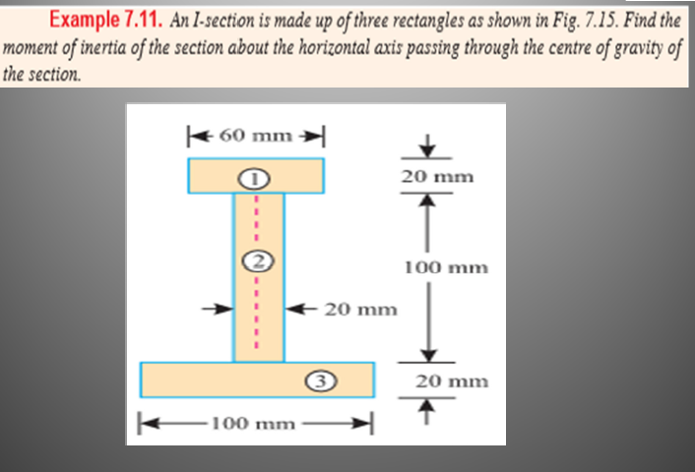

Slide 3
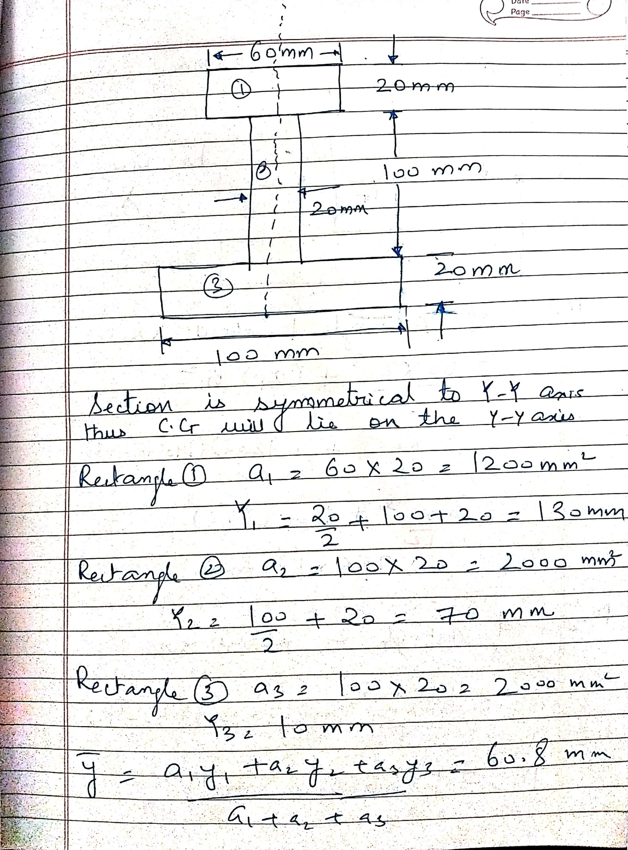

Slide 4
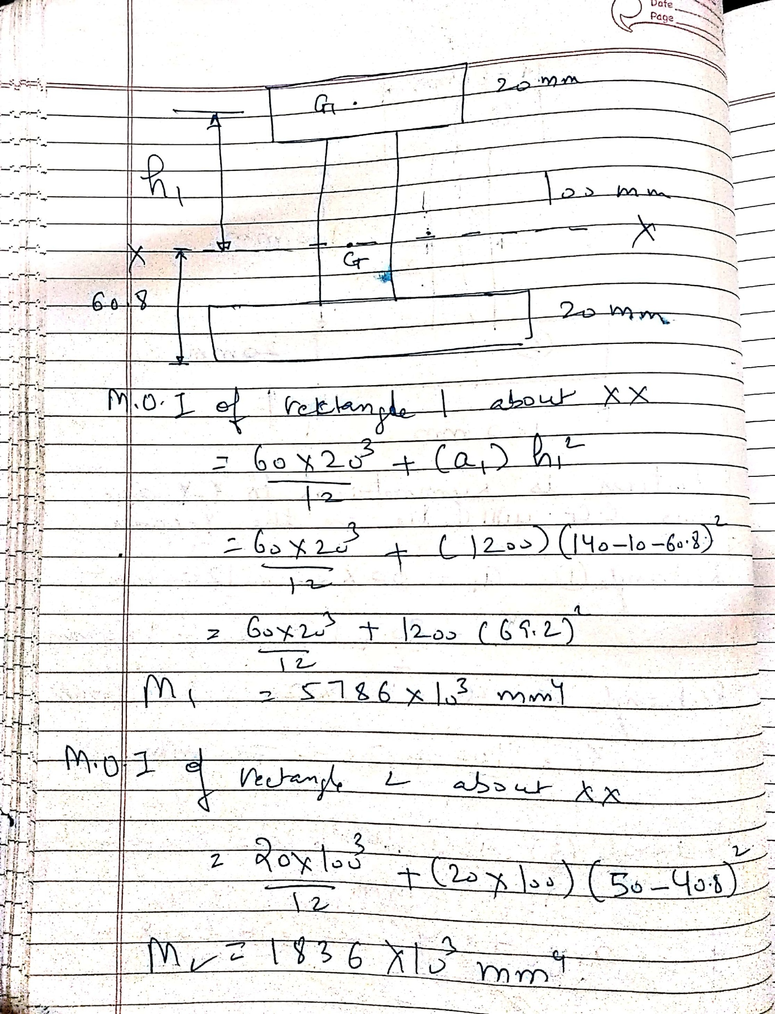

Slide 5
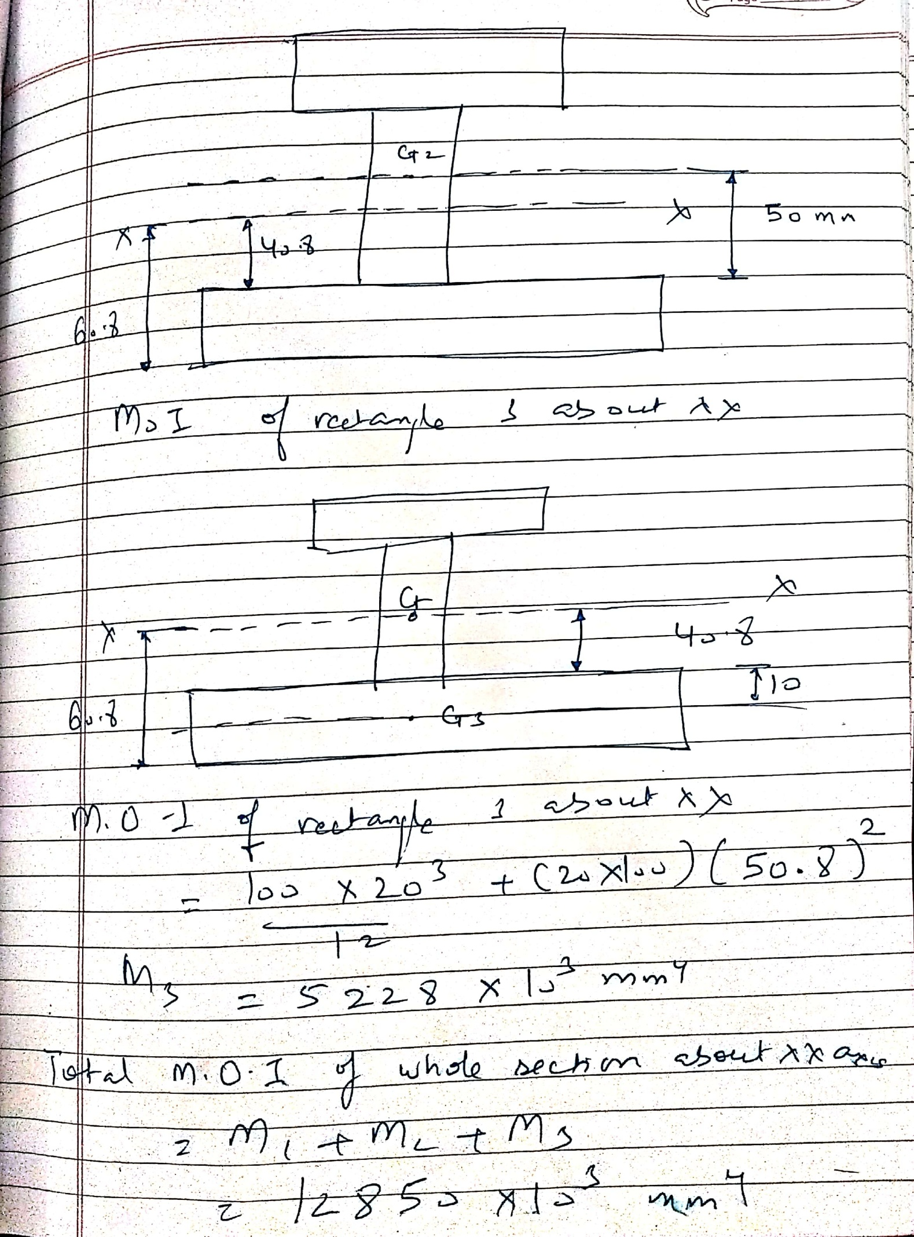

Slide 6
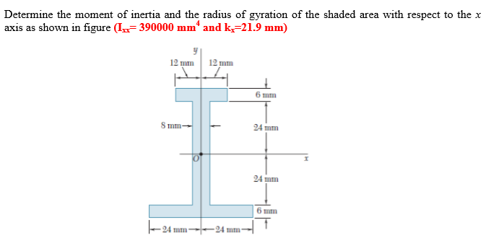

Slide 7
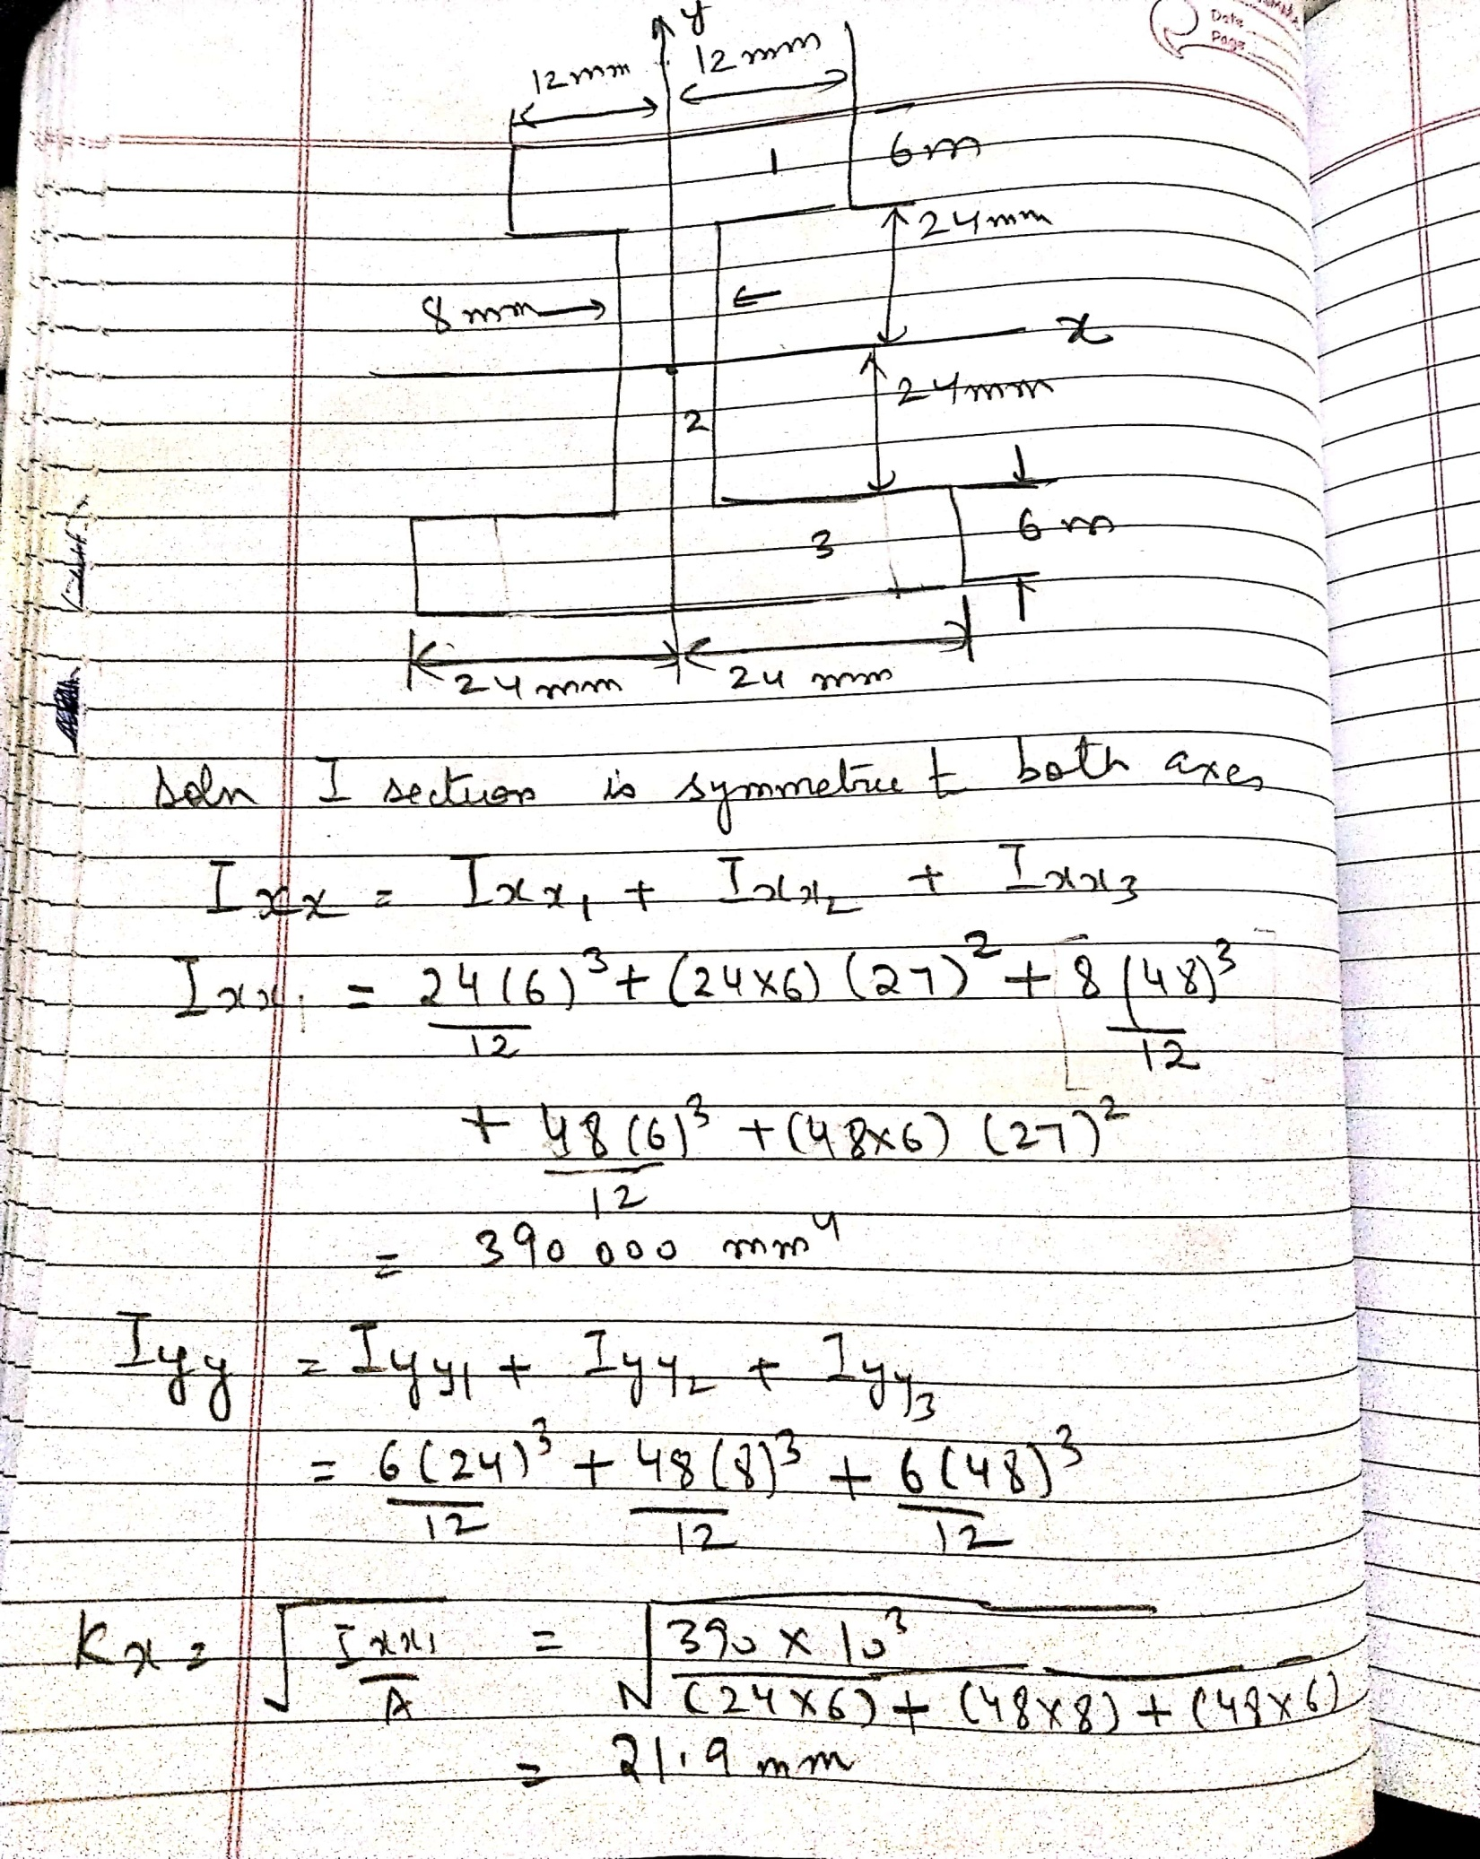

Slide 8
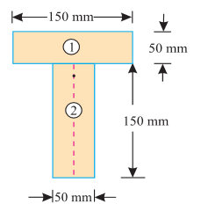

Slide 9
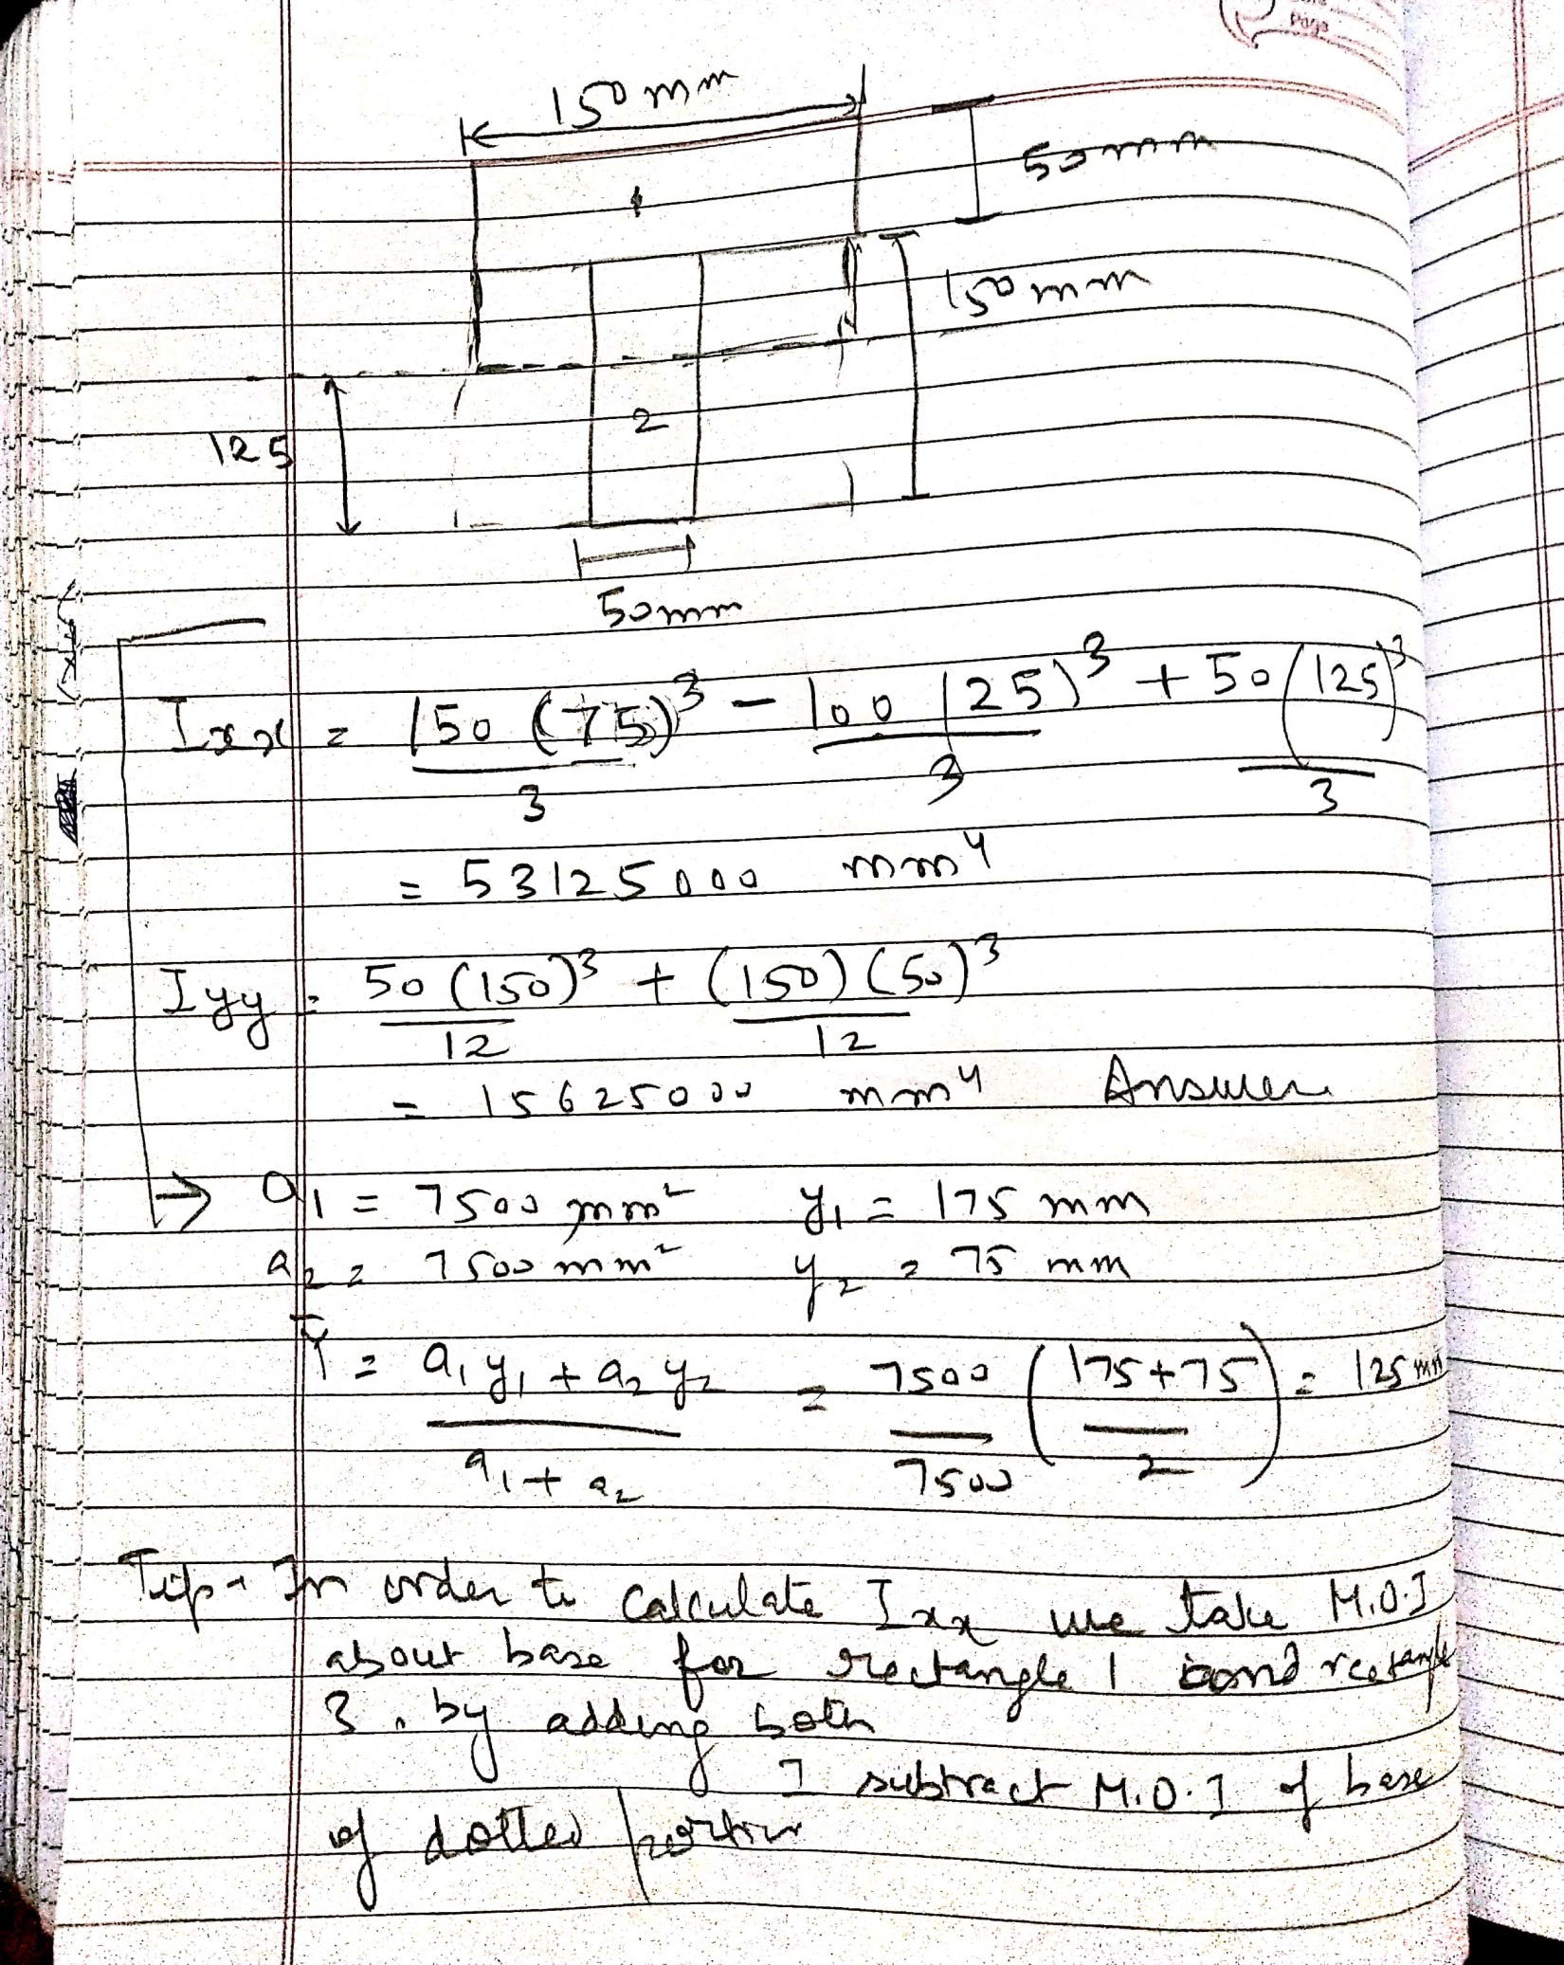

Slide 10
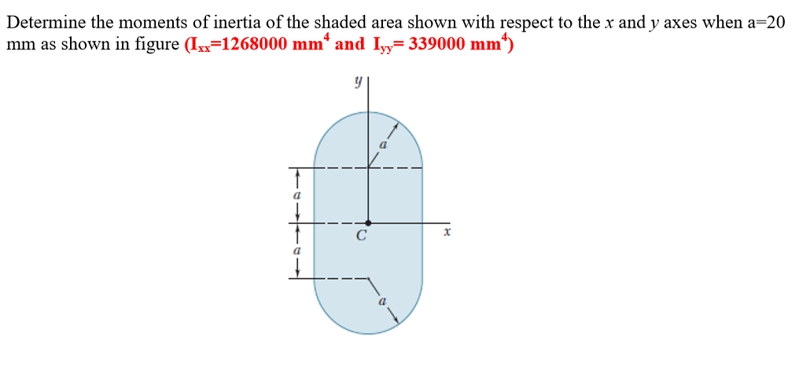
Semicircle Moment of inertia
Ix (about c.g) | Iy(about c.g)
0.11R⁴ | πR⁴/8

Slide 11
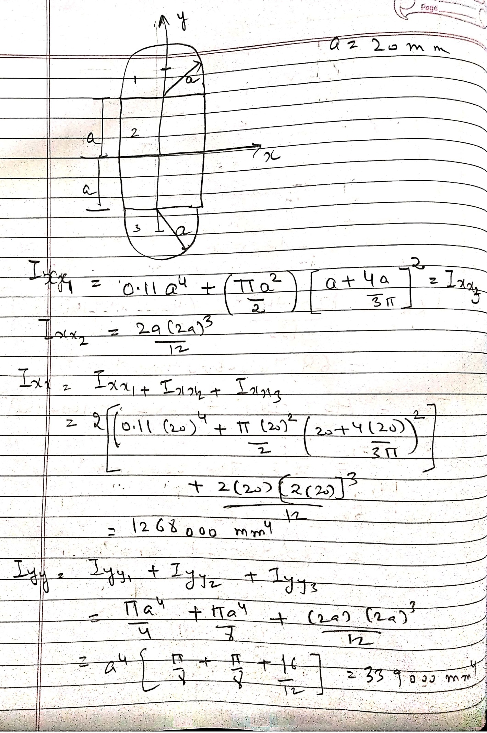

Slide 12
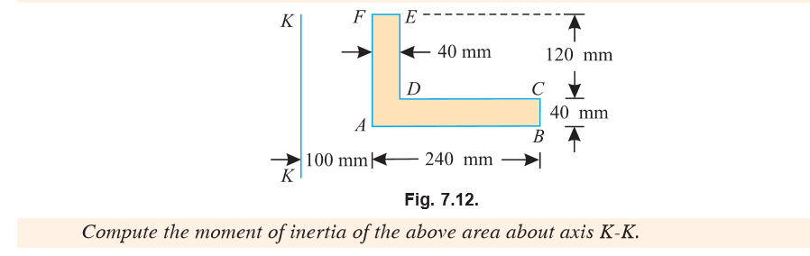

Slide 13
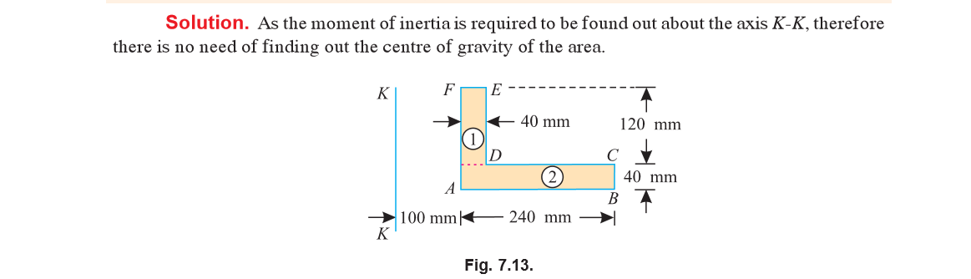

Slide 14
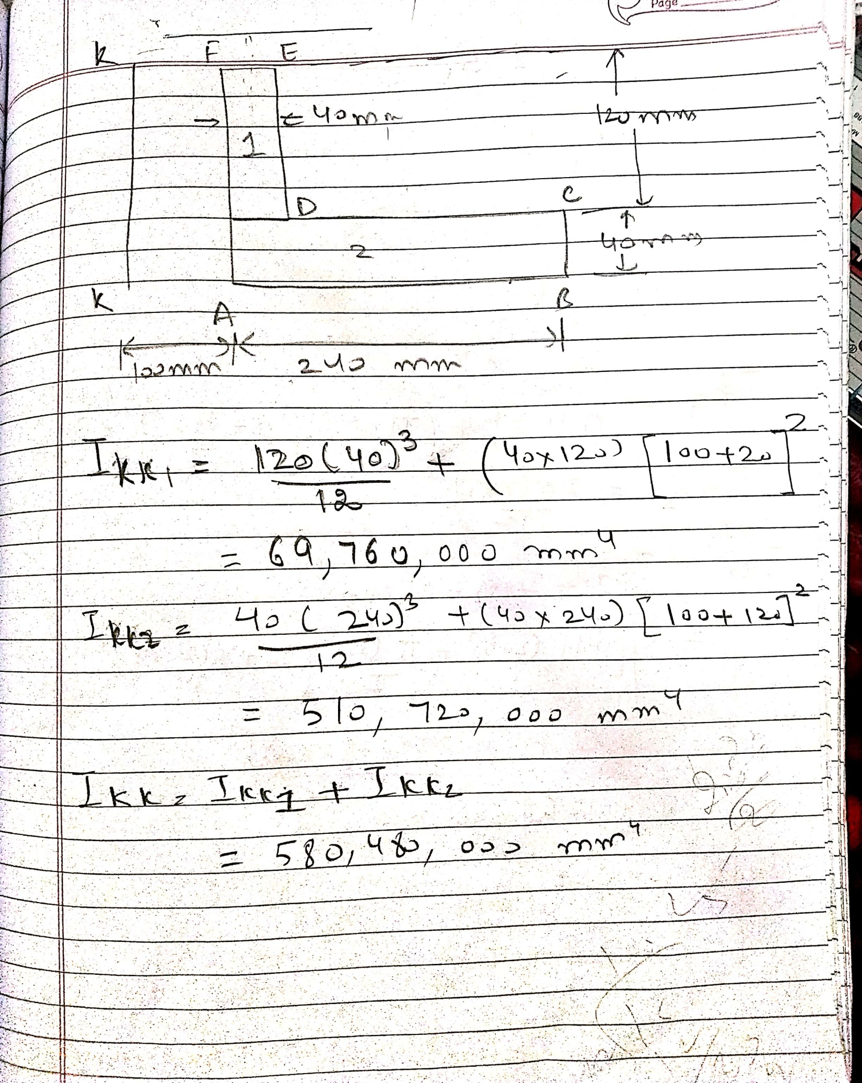

Slide 15
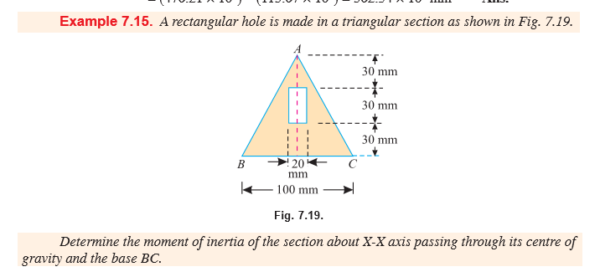

Slide 16
